Slide 1


Department of Information Science and Engineering
Department of Information Science and Engineering
Electronics Health Records Management And Patients health monitoring system using cloud Technologies
Student Names and USN
Akshata B Anjutagi 1NT19IS401
Lavanya k 1NT19IS407
Renuka Karadagi 1NT19IS412
Yashodha M N 1NT19IS416
Internal /External Guide Name, and Designation
Mrs. Navya C
Assistance Professor,
Department of ISE
NMIT
Date : 07 -05-2021

Slide 2
Contents
Objectives
Problem Statement
System Design
Implementation

Slide 3
Objectives
Maintain and store Patients health records in cloud.
Provide patients previous health details to doctors and hospital for easy diagnose.
Monitor the health parameters like body temperature and heart beat by using sensor.
Use Internet of Things to check patient health condition remotely from anywhere from the world.

Slide 4
Problem Statement
A patient may visit a hospital for treatment of particular disease or illness .
Sometimes may have to be promoted to a hospital with better facilities and technological advancements .
In such a case a database which be accessed by every hospital is necessary .
Therefore our project aims on providing database and a web page which can be accessed by all the hospitals.

Slide 5
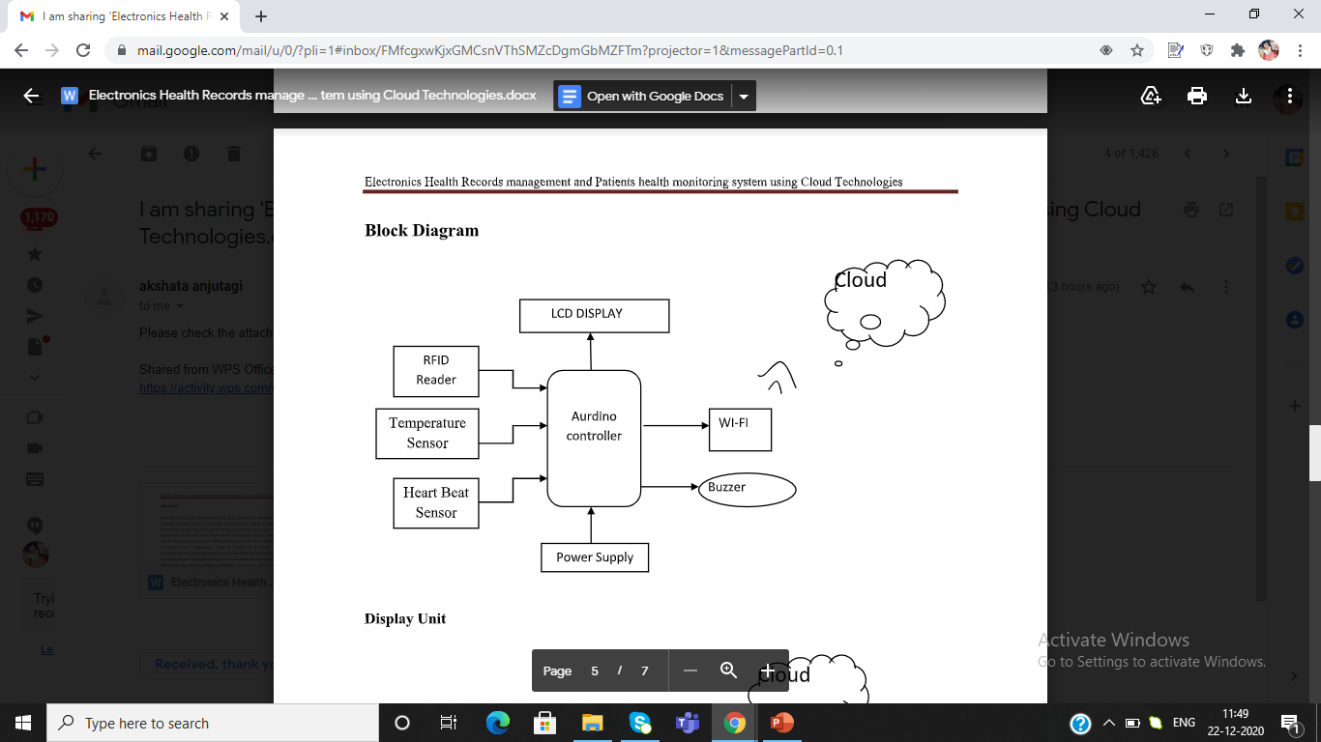
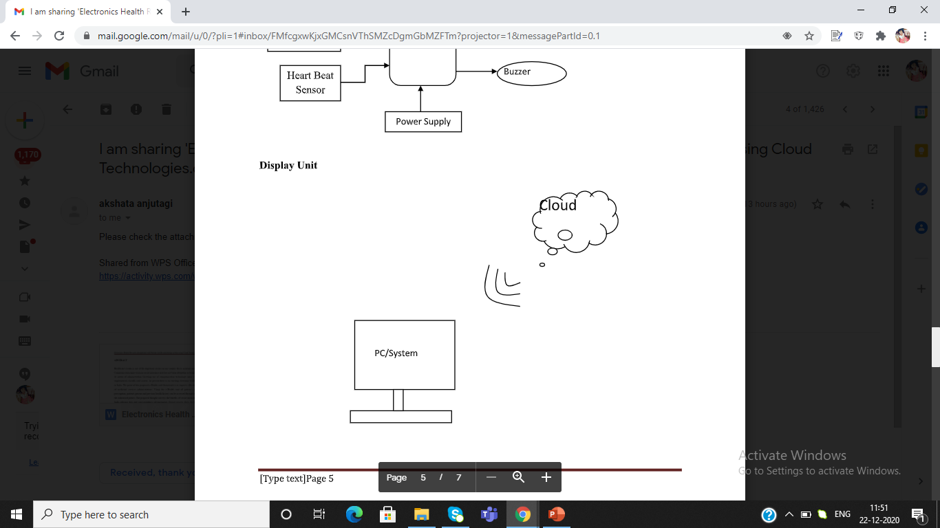
SYSTEM DESIGN

Slide 6
System Requirements
Software Used
Arduino IDE
Embedded C
Linode cloud Services
Components Used
Arduino Microcontroller
RFID Reader, Temperature sensor, Heartbeat Sensor,ESP8266 module
Buzzer, 12v Adaptor

Slide 7
System Requirements
Software
Language : JAVA 8
Frameworks : Spring Cloud, Hibernate 5.0
Database : MySQL
Operating system : Ubuntu/Windows ,AWS cloud
Arduino IDE
Embedded C
Hardware requirements
Hard disk : 40 GB
Ram : 2GB
Processor : dual core/i3 4 cores

Slide 8
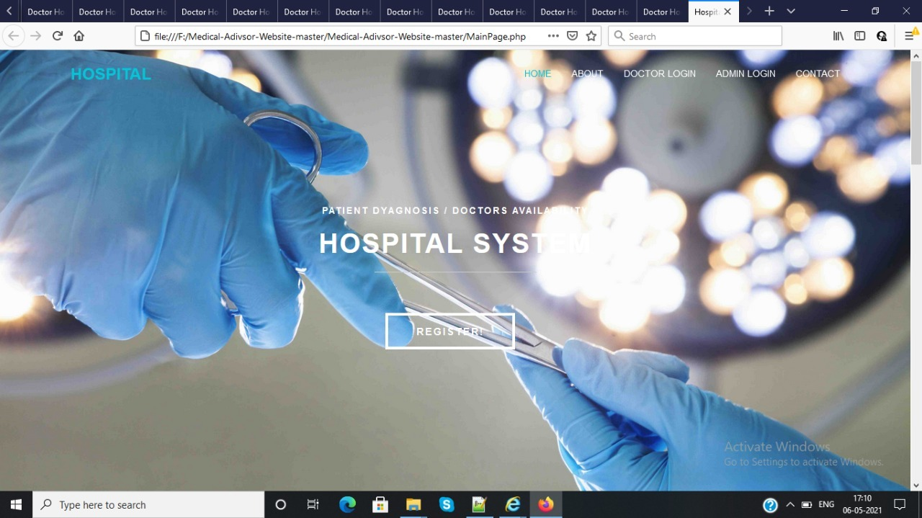
Implementation
HOME PAGE

Slide 9
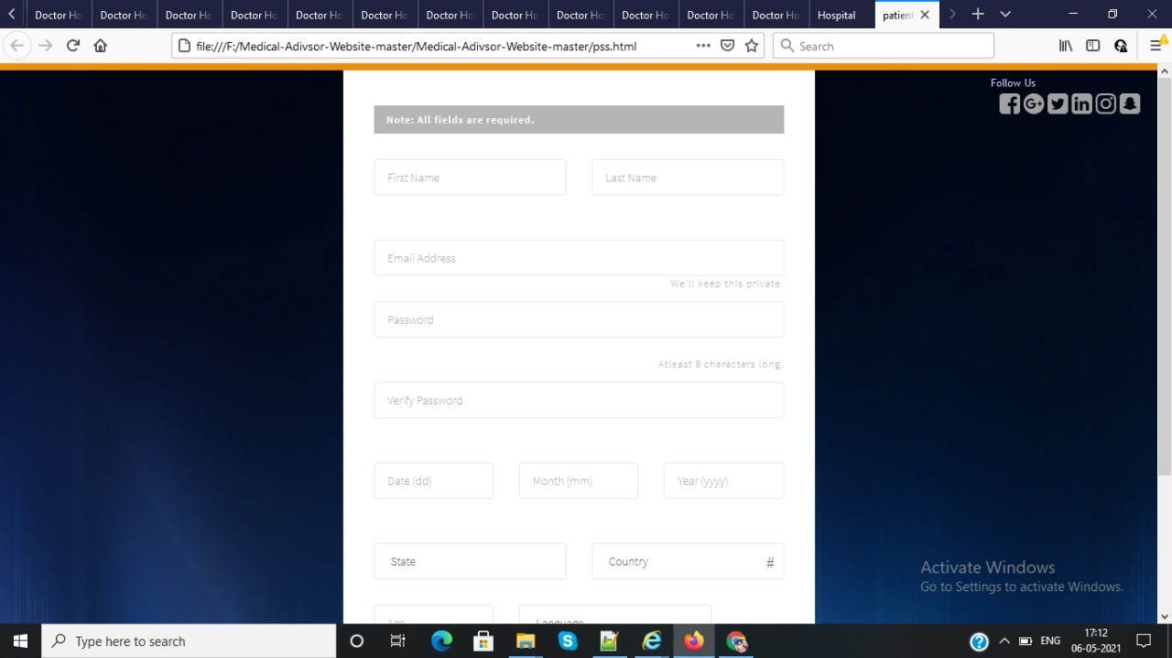
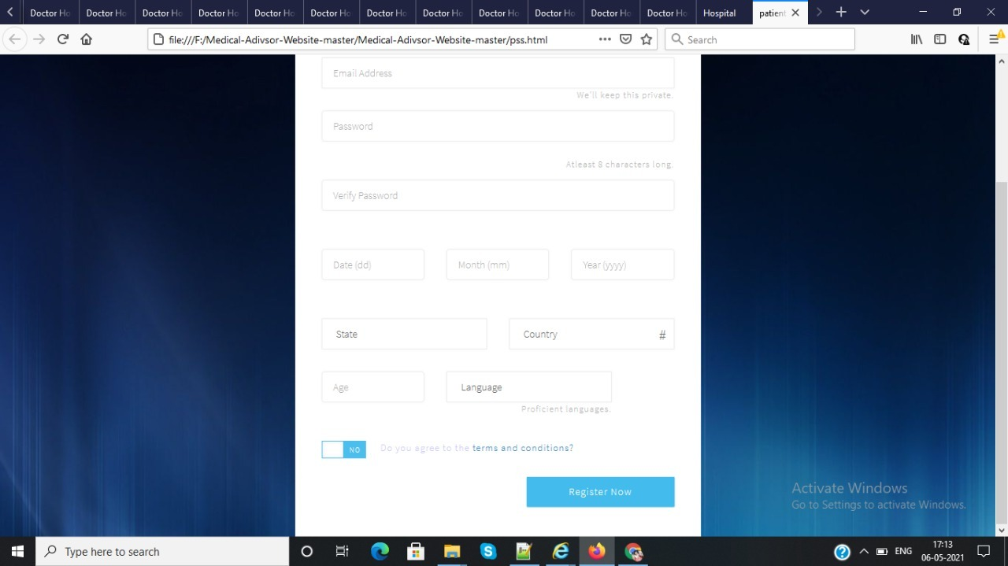
Implementation
PATIENT LOGIN PAGE

Slide 10
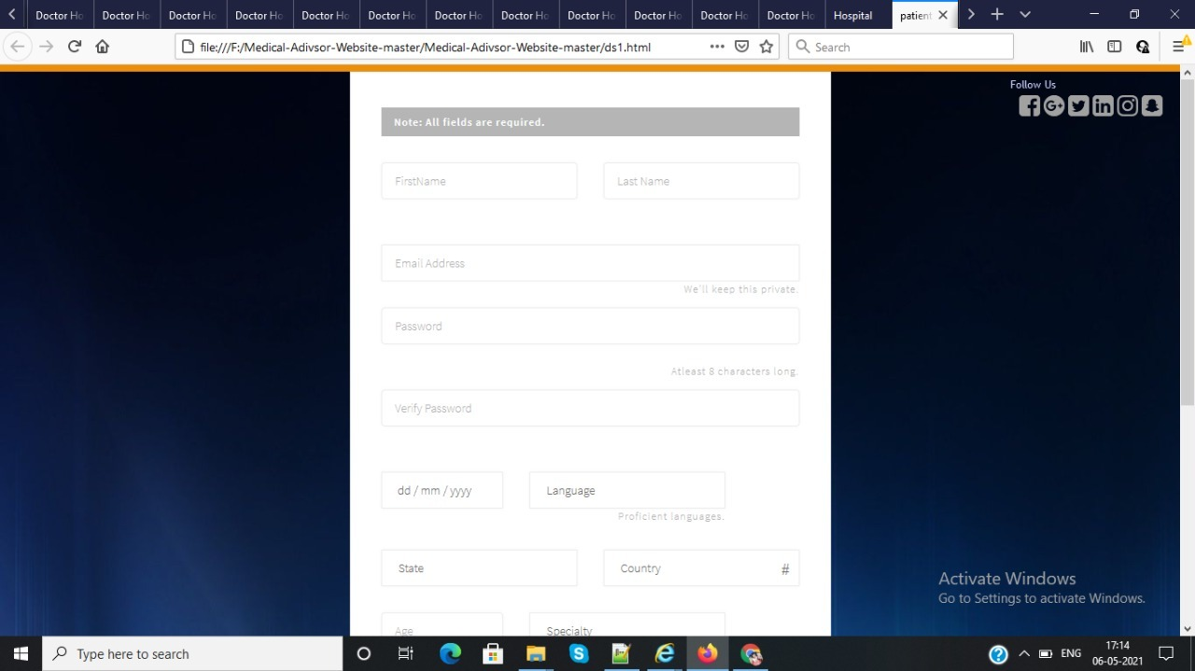
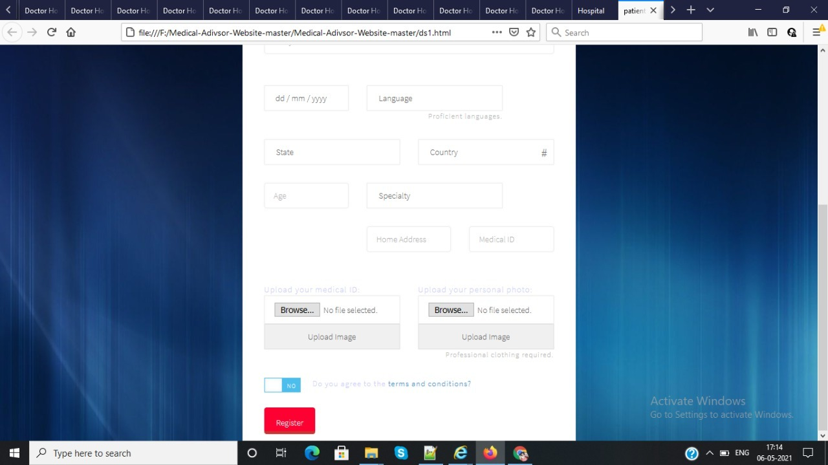
Implementation
Doctor’s Login Page

Slide 11
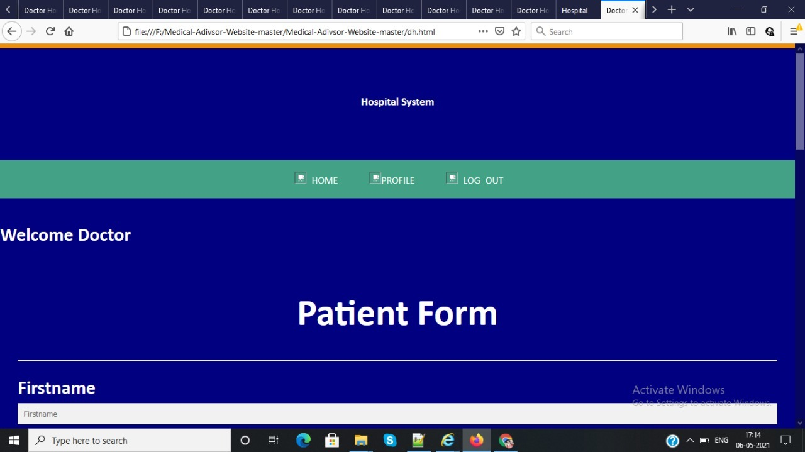
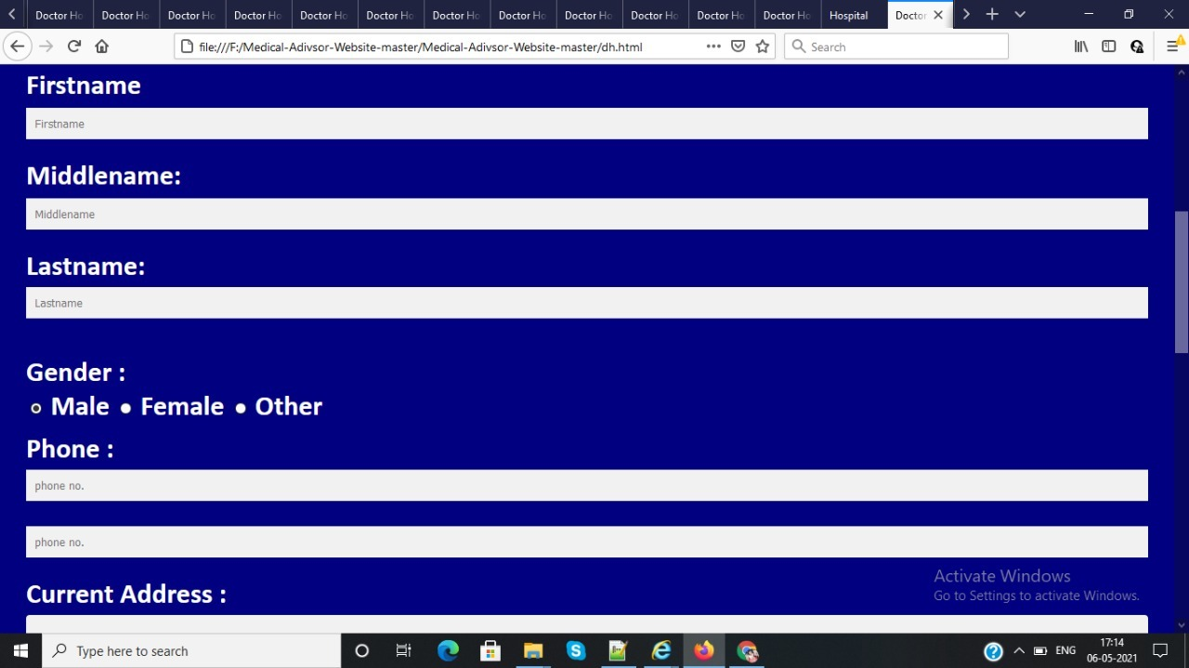
Implementation
Patient details page

Slide 12
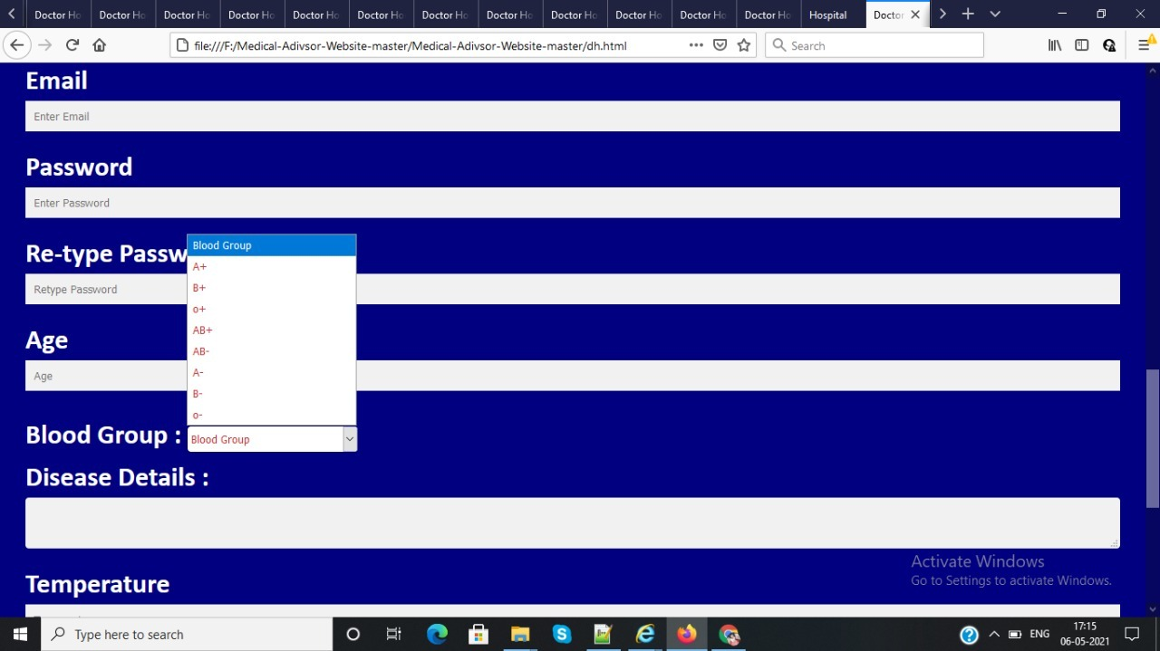
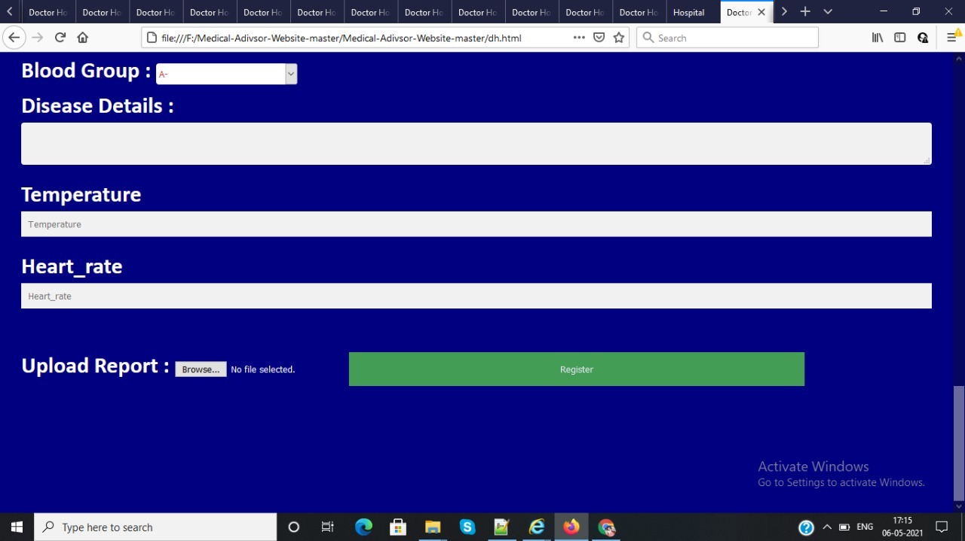
Implementation

Slide 13

Thank you

